Slide 1

IoT Based Smart Automation Using WPA2 security & Radius Server in Cisco Packet Tracer
Group Members:
04/15/2024

Slide 2

Abstract
This presentation delves into the convergence between smart home technology and advanced business data communication systems, aiming at the use of high-customizability IoT to create a securely intelligent network that services both personal and business life.
This combination of comfort and innovation is a vision of the future of the interconnective living and working environment.

Slide 3

Introduction
This IoT Project is a revolution in the way in which we interact with our household and business tools. The construction of a smart home environment using IoT devices is an example of this project.
This approach demonstrates how conference business information and information communications can be expanded and adjusted .
The implementation lays a foundation for further exploration of advanced solutions and tactical alignment that can enhance performance and management in intelligent areas.

Slide 4
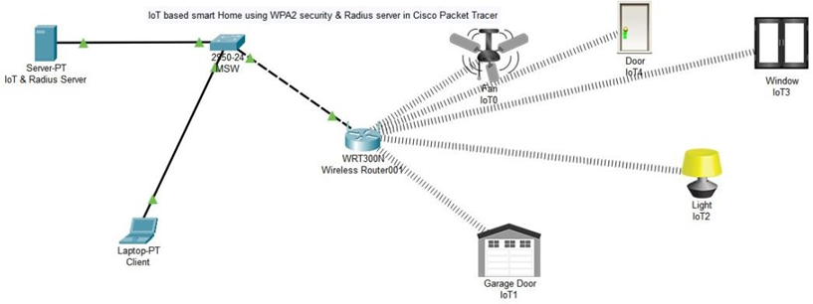
Current Network Topology
The current network topology establishes the foundation of our smart home system
This setup provides a backbone for a range of IoT devices, enabling centralized control and communication through a single client laptop
The configuration represents the core upon which our smart home operates, ready to scale to the demands of business-level operations

Slide 5
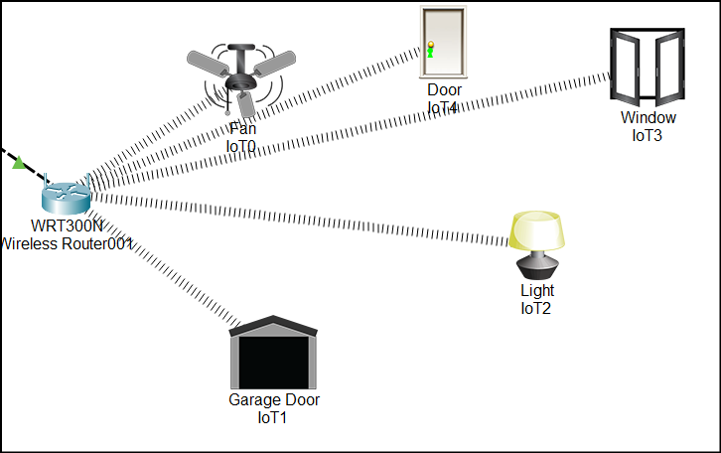
Current IoT Devices and Control
The smart home network currently comprises a suite of IoT devices: Fan, door, garage door, and lighting and window each connected wirelessly and managed via a web-based control panel
This interface allows users to monitor and control their smart home devices remotely, giving real-time feedback and the flexibility to adjust settings on the go
It is a testament set up to convenience and modern home management

Slide 6
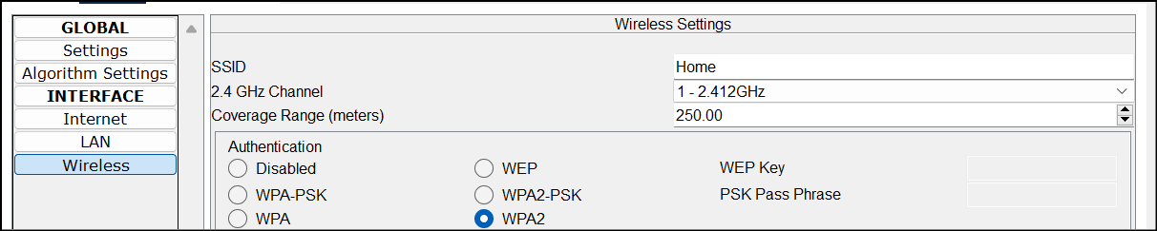
Security Implementation
At the forefront of our network design is security, anchored by WPA2 encryption and Radius server authentication
These security measures are critical in safeguarding the data integrity and privacy of the smart home occupants
They prevent unauthorized access and ensure that communication between devices and the control client remains confidential and secure

Slide 7
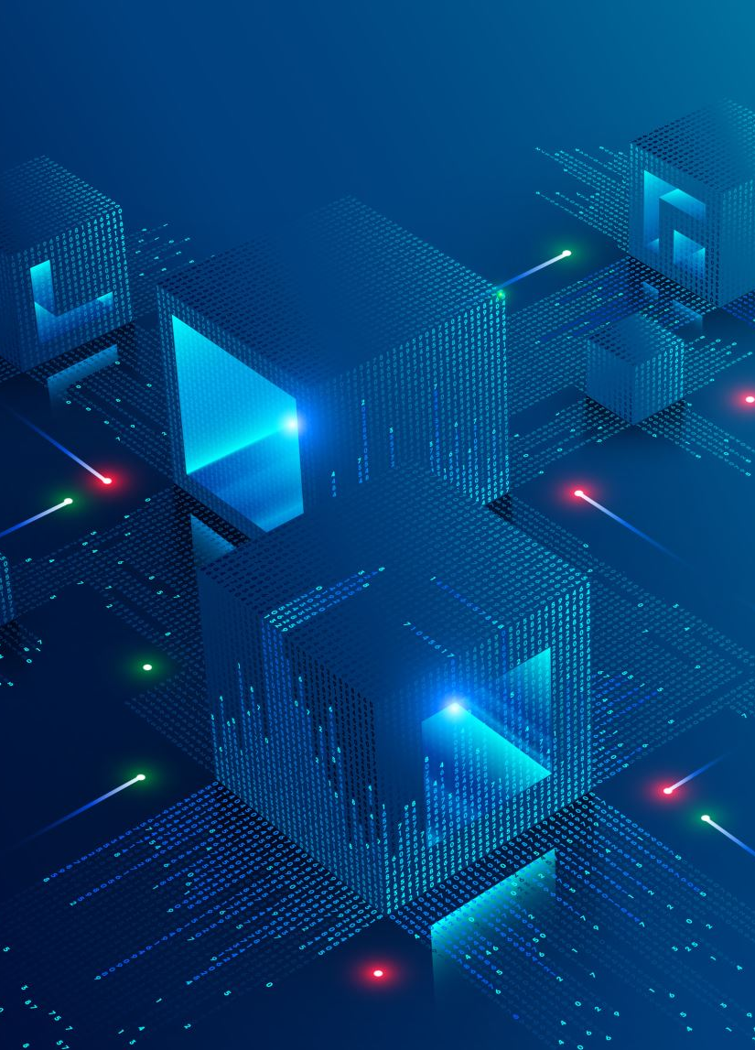
Theoretical Expansion Overview
We propose a visionary expansion of our IoT smart home into business data communications
The conceptual evolution encompasses advanced device integration, network segmentation, and enhanced user interfaces
Tailoring the smart home to also serve as a nerve center for business operations, thus a truly intelligent and responsive home-business environment

Slide 8
Integrating Business-Oriented IoT Devices
Addition of business-oriented IoT devices can transform a smart home into a smart business hub
By incorporating devices like smart thermostats for climate control and energy savings, intelligent security cameras for enhanced monitoring, and advanced access systems for secure entry, we can elevate the functionality of the IoT network to meet the dynamic needs of modern businesses

Slide 9
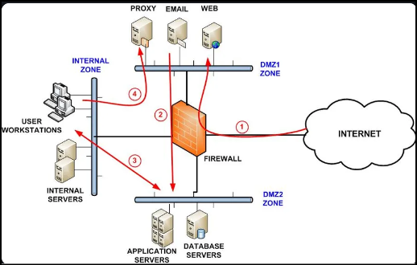
Network Segmentation for Security and Efficiency
Network segmentation stands to be a strategic enhancement to our IoT framework, partitioning the network into distinct segments for guests and critical business operations
This approach will not only bolsters security by isolating sensitive data but will as well improve overall network performance by managing traffic flow and prioritizing bandwidth allocation

Slide 10
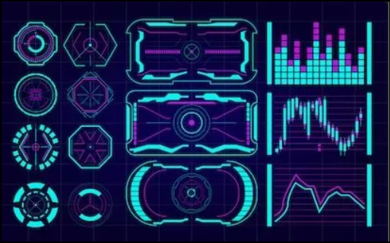
Advanced Control Panel for User Interface
An advanced control panel will revolutionize the way users interact with the IoT ecosystem
Equipped with detailed analytics and automated scheduling capabilities, the upgraded interface will give in-depth insights into device performance and energy usage, enabling optimized and predictive home management

Slide 11
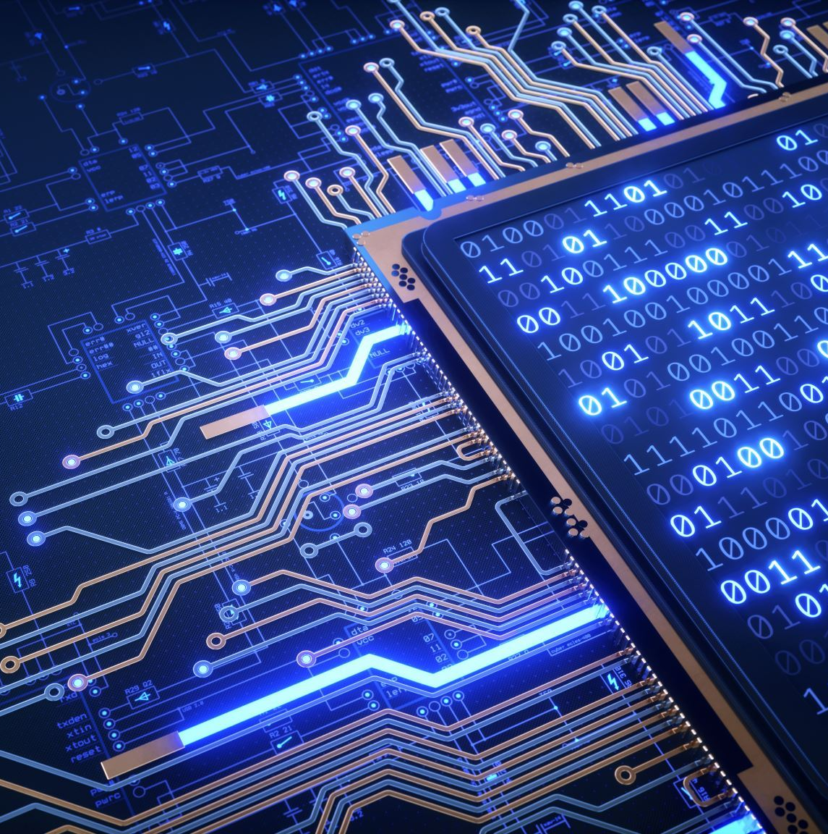
Voice Control and Machine Learning Integration
The future of IoT lies in hands-free control and personalized automation
Voice control integration will allow users to manage their IoT devices using simple voice commands.
Machine learning algorithms can learn user preferences and habits over time, adjusting the smart environment to suit individual needs even before they are expressly communicated

Slide 12
Business Application Dashboard
A business application dashboard can extend the utility of the smart home to corporate settings and thus enabling centralized control of IoT devices across various office locations
This dashboard can provide managers with real-time data on the status and performance of each device, ensuring seamless operation and maintenance

Slide 13

Energy Efficiency and Predictive Maintenance
In business context, energy efficiency and predictive maintenance are key considerations
Integrating IoT with HVAC systems based on occupancy data can dramatically reduce energy costs
Meanwhile, predictive maintenance capabilities enable the network to alert businesses to potential device failures before they occur, minimizing downtime

Slide 14

Predictive Analytics and Reporting for Businesses
Predictive analytics and detailed usage reporting for empowering businesses with the foresight to make informed decisions
By analyzing trends and performance data, the IoT system can help anticipate future challenges and opportunities, therefore streamlining operations and contributing to strategic business planning

Slide 15
Data Communication Security Enhancement
As the IoT network expands, the enhancement of data communication security becomes paramount
Upgraded encryption protocols and security measures will be essential to protect against evolving threats, making sure that all business communications remain secure and confidential

Slide 16
Conclusion
In conclusion, the expansion of the IoT smart home project opens up a world of possibilities for business integration and data communication
1
By adopting the described advanced IoT solutions, businesses can not only enhance operational efficiency but also foster a more secure, intuitive, and responsive environment
2
The theoretical conceptual expansion underscores the vast potential IoT holds for transforming not just our living spaces but also the way we conduct and manage business operations
3

